Slide 1
Project Report
ENERGY AND PERFORMANCE AWARE TASK SCHEDULING IN A MOBILE CLOUD COMPUTING ENVIRONMENT IN C++
BY
S.ANIRUDH

Slide 2
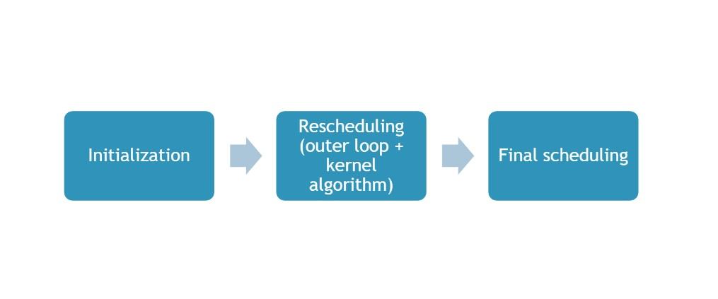
This is the main idea behind the algorithm

Slide 3
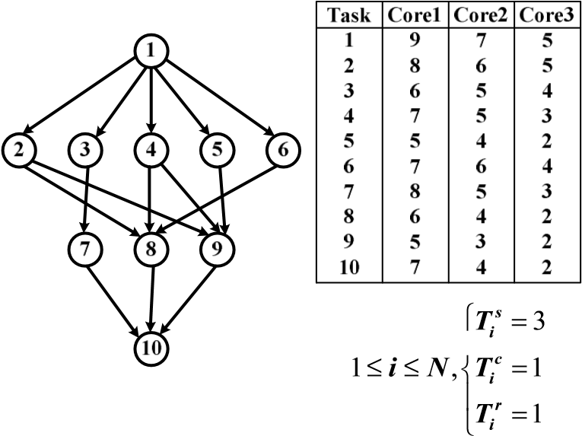
Task Graph 1

Slide 4
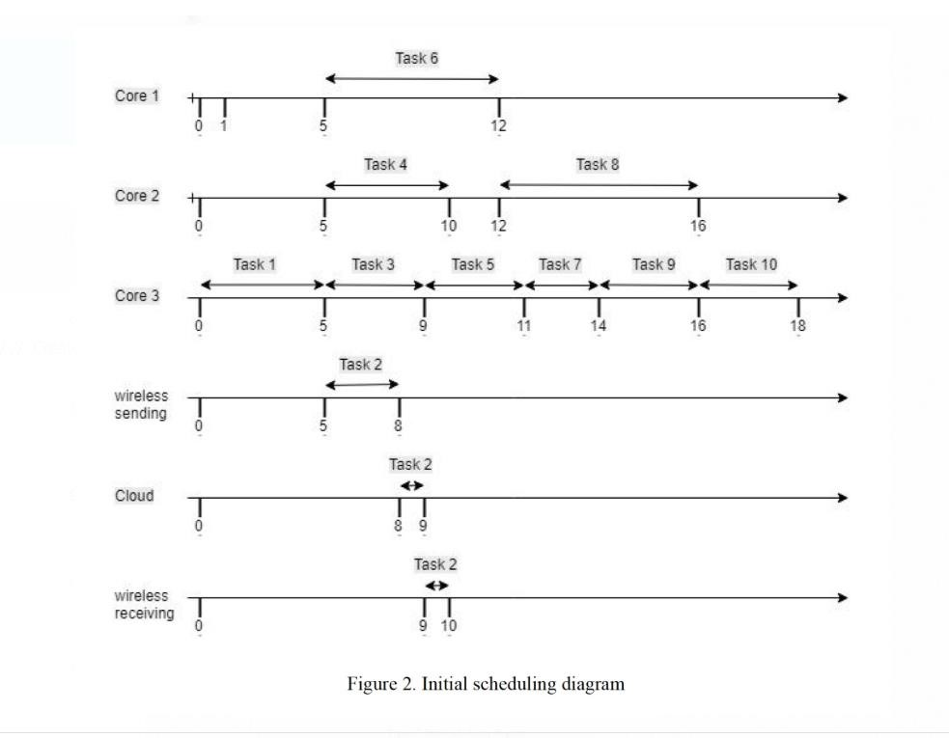
Initial Scheduling Algorithm Result
Total Energy Consumed for initial scheduling E_Total =122 units
Total Execution Time T_Total =18 units
So the max time for next step should not exceed Tmax=1.5*T_Total=27 units

Slide 5
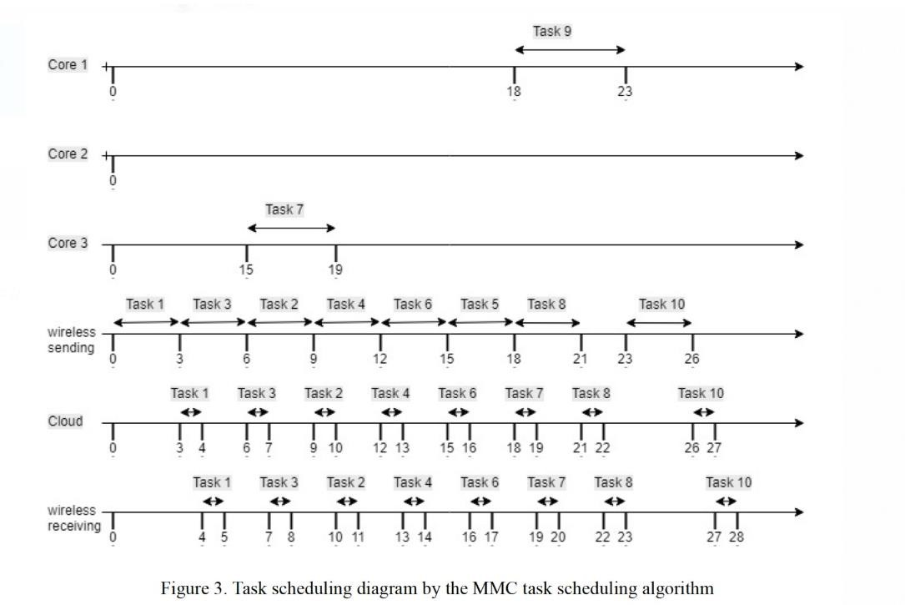
Task Scheduling Diagram By MCC Task Scheduling Algorithm
Total Energy Consumed for initial scheduling E_Total =22 units
Total Execution Time T_Total =24 units
Program running time=218ms

Slide 6
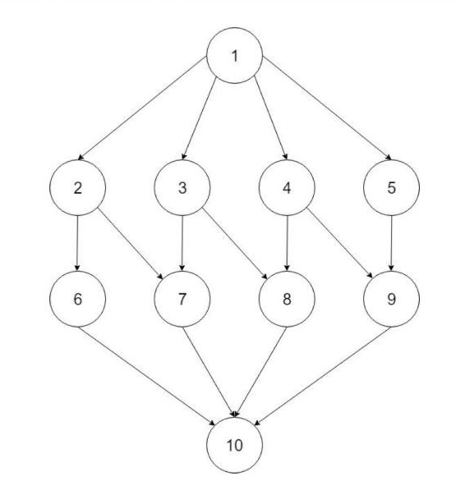
Task Graph 2

Slide 7
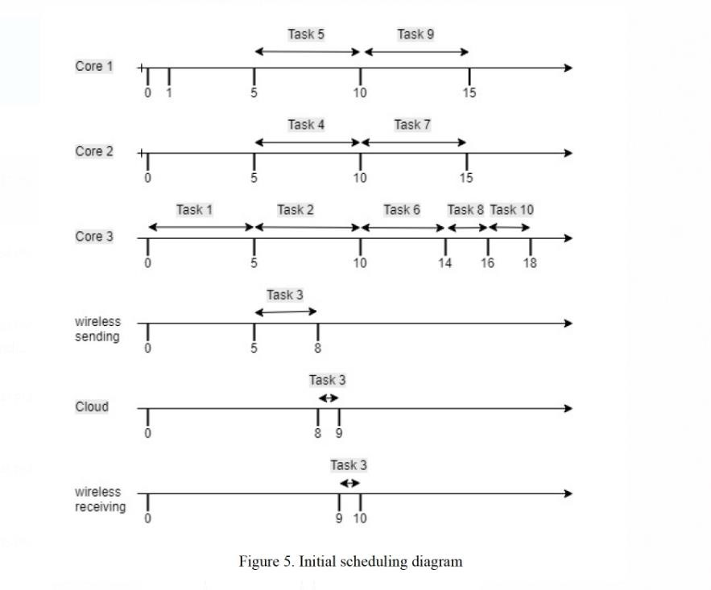
Initial Scheduling Algorithm Result
Total Energy Consumed for initial scheduling E_Total =123 units
Total Execution Time T_Total =17 units
So the max time for next step should not exceed Tmax=1.5*T_Total=25.5 units

Slide 8
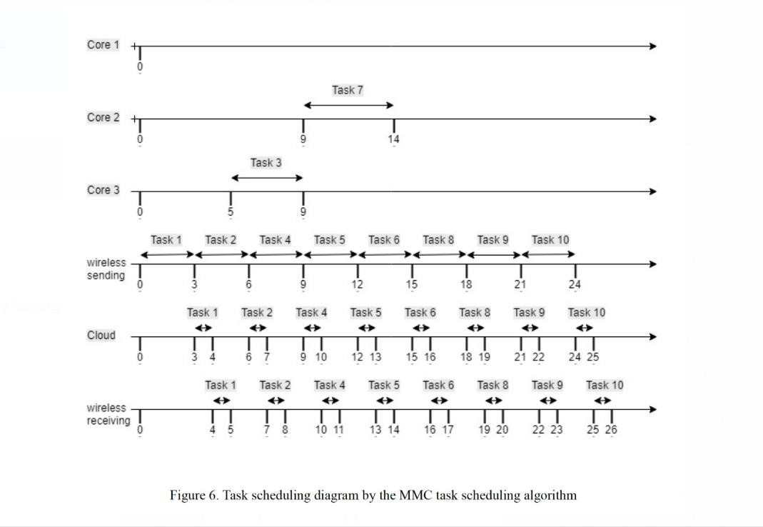
Task Scheduling Diagram by MCC Task Scheduling Algorithm
Total Energy Consumed for initial scheduling E_Total =25 units
Total Execution Time T_Total =23 units
Program running time=275ms

Slide 9
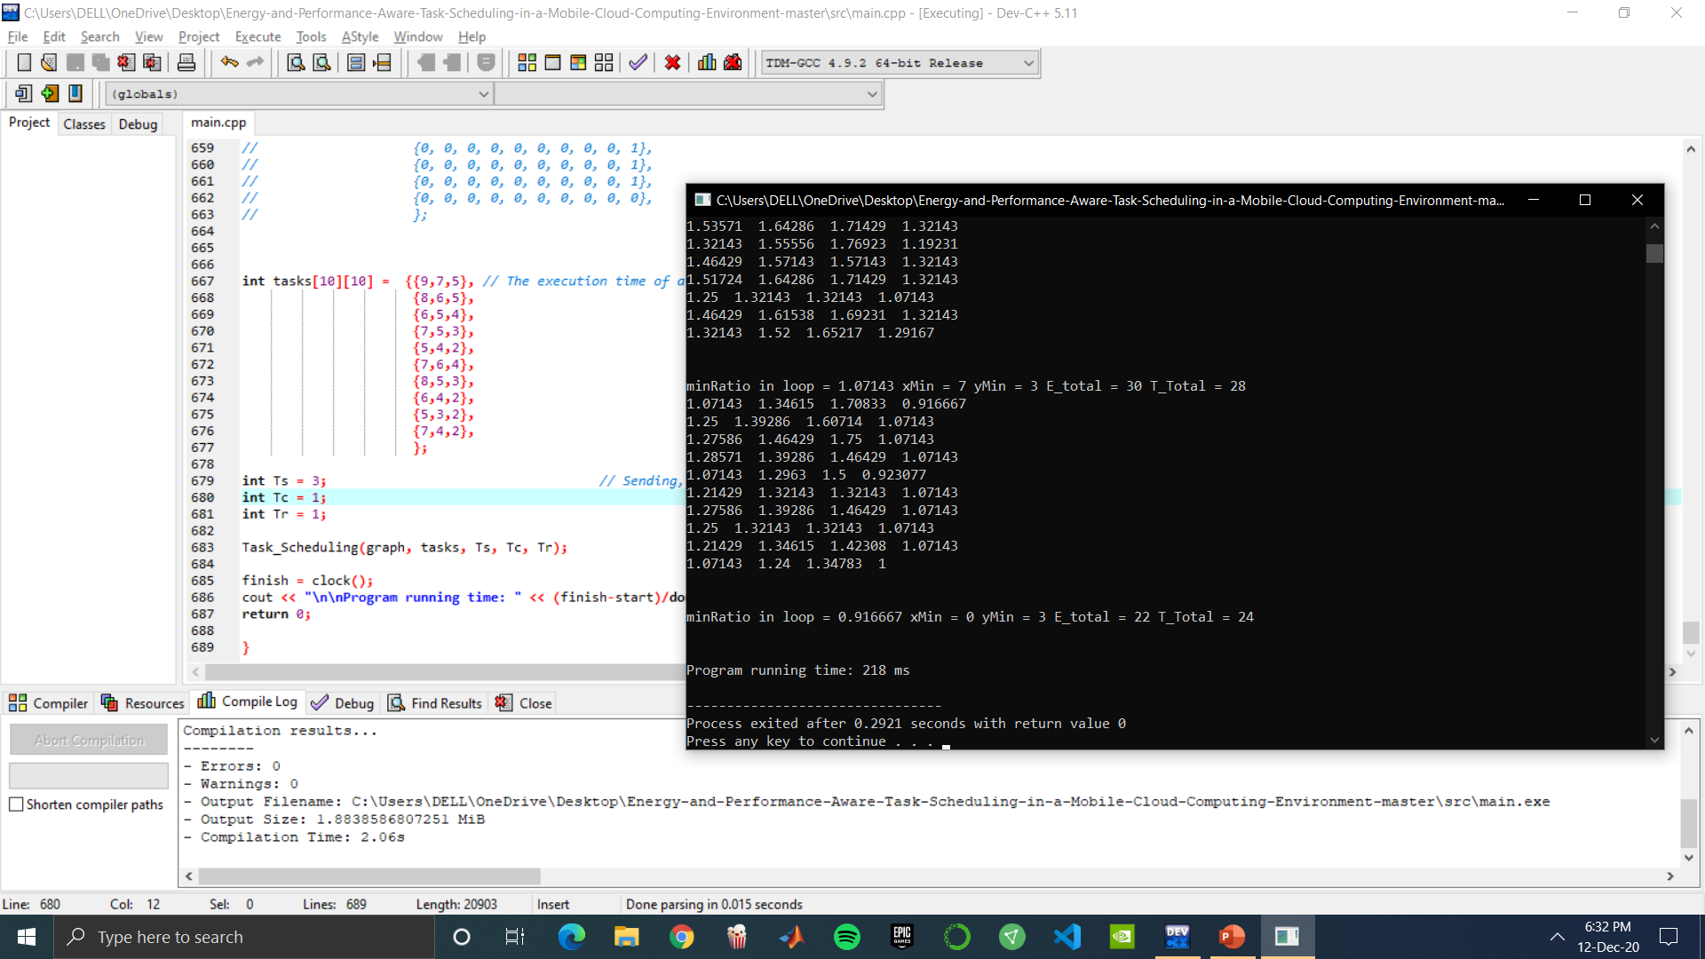
SCREENSHOT

Slide 10
CODE:
#include<iostream>
#include<cstdlib>
#include<vector>
#include<algorithm>
#include<time.h>
using namespace std;
# define V 10 // The number of tasks
# define C 3 // Number of cores
void copy(int arr[V], int arr1[V]){ // To duplicate the arrays for further manipulations
for(int i=0; i<V; i++){
arr1[i] = arr[i];
}
}
int maximum(int arr[C]){ // To find maximum in an array of C elements
int maxi = arr[0];
for(int i=1; i<C+1; i++){

Slide 11
if(arr[i] > maxi){
maxi = arr[i];
}
}
return maxi;
}
void reset(int seq1[V], int seq[V]){ // reset the elements of the intial scheduling sequence during task migration step.
for(int i=0; i<V; i++){
seq1[i] = seq[i];
}
}
int minimum(int arr[], int n){ // Maximum of an array with 4 elements
int mini = arr[0];
for(int i=0; i<=n; i++){
if(arr[i] < mini){
mini = arr[i];
}
}

Slide 12
return mini;
}
int minimum_index(int arr[], int n){ // Find the index of the minimum element present in the array.
int min_index = 0;
int mini = arr[0];
for(int i=0; i<=n; i++){
if(arr[i] < mini){
mini = arr[i];
min_index = i;
}
}
return min_index;
}
int clear1(int arr[V]){ // makes all ele = -1
for (int i=0; i<V; i++){
arr[i] = -1;
}
return arr[V];
}
int checkifpresent(int a, int arr[V]){ // if ele a present in array arr, 1 is returned
int ans=0;
for(int i=0;i<V;i++){

Slide 13
if(arr[i] == a){
ans = 1;
}
}
return ans;
}
void unlock(int graph[V][V], int Exe_current, int unlocked_tasks[V]){ // to unlock all the successors
for(int j=0; j<V; j++){
if(graph[Exe_current][j] == 1){
unlocked_tasks[j] = j; // So, Now all positive values in Unlocked_tasks are ready to be scheduled.
}
}
}
void reverseArray(int arr[], int start, int end) // to reverse an array
{
while (start < end)
{
int temp = arr[start];
arr[start] = arr[end];
arr[end] = temp;

Slide 14
start++;
end--;
}
}
int clear(int arr[V]){ // to make all elements in that array = 0;
for (int i=0; i<V; i++){
arr[i] = 0;
}
return arr[V];
}
void printarray1D(int arr[],int n){ // A Function to print 1D arrays
for(int i=0;i<V;i++){
cout <<arr[i]<< "\t";
}
}
void printvector1D(vector<int>arr){ // Print 1 Dimensional arrays
for(int i=0; i<arr.size(); i++){
cout << arr[i] << "\t";}}

Slide 15
// Function to optimize the sequence untill we get desired results.
vector <float> optimize(int seq2[V], int seq3[V], int Total_energy11[V][C+1], int Total_time11[V][C+1], int priority_index[V], int graph[V][V], int timeCore[C], int T_re[V], int power[C],int tasks[V][V]){
vector<float> returnval;
int presentTask;
int newEndtime[V];
clear(newEndtime);
int energyTotal = 0;
int finishTime = 0;
float energyTimeRatio[V][C+1];
returnval.clear();
for(int i=0; i<V; i++){ // each element in the sequence
for(int j=0; j<C+1; j++){ // change each element for each core and iterate to calculate total power and energy
seq3[i] = j;
//presentTask = priority_index[i];
for(int k=0; k<V; k++){ // to iterate through all tasks in seq1

Slide 16
presentTask = priority_index[k];
// Here check if parents have executed the tasks, if not then change the newendtimes values.
for(int parent = 0; parent <V; parent++){
if(graph[parent][presentTask] == 1){
if(newEndtime[parent] > timeCore[seq3[k]]){
timeCore[seq3[k]] = newEndtime[parent];
}
}
}
// Calculate the finish time on the corresponding core
if(seq3[k] == 3){ // if it has to be executed on cloud, then tasks[task][3] wouldn't exist
timeCore[seq3[k]] = timeCore[seq3[k]] + 3;
energyTotal = energyTotal + 0.5*3;
}
else
{
timeCore[seq3[k]] = timeCore[seq3[k]] + tasks[presentTask][seq3[k]];
energyTotal = energyTotal + power[seq3[k]] * tasks[presentTask][seq3[k]];}
if(seq3[k] == 3){

Slide 17
newEndtime[k] = timeCore[seq3[k]] + 2; // Update the new endtime over that task
}
else
{
newEndtime[k] = timeCore[seq3[k]];
}
finishTime = maximum(timeCore);
// Now clear the timeCore values for the next iteration
timeCore[0] = 0;
timeCore[1] = 0;
timeCore[2] = 0;
timeCore[3] = 0;
}
Total_energy11[i][j] = energyTotal;
Total_time11[i][j] = finishTime;
// finishTime2.push_back(finishTime);
//Total_energy1.push_back(energyTotal);
//Total_time1.push_back(finishTime);
energyTotal = 0;
finishTime = 0;
reset(seq3, seq2);}
reset(seq3, seq2);

Slide 18
}
for(int i=0; i<V; i++){
for(int j=0; j<=C; j++){
energyTimeRatio[i][j] = (float)Total_energy11[i][j] / (float)Total_time11[i][j]; // int float casting.
cout << energyTimeRatio[i][j] << " ";
}
cout << endl;
}
float minRatio = energyTimeRatio[0][0]; // finding minRatio and its indices for first iteration manually.
int xMin=0;
int yMin=0;
for(int i=0;i<V;i++){
for(int j=0; j<=C; j++){
if(minRatio > energyTimeRatio[i][j]){
minRatio = energyTimeRatio[i][j];
xMin = i;
yMin = j;
}
}
}
cout << "\n\nminRatio in loop = " << minRatio << " xMin = " << xMin << " yMin = " << yMin << " E_total = " <<

Slide 19
Total_energy11[xMin][yMin] << " T_Total = " << Total_time11[xMin][yMin] << endl;
returnval.push_back(minRatio);
returnval.push_back(xMin);
returnval.push_back(yMin);
return returnval;
}
void Task_Scheduling(int graph[V][V], int tasks[V][V], int Ts, int Tc, int Tr){ // Main Task_scheduling Algorithm
int T_L_min[10];
for(int i=0; i<10;i++){ // Calculating T_L_min
int min_temp = tasks[i][0];
for (int j = 0; j <2; j++) {
min_temp > tasks[i][j+1];
min_temp = tasks[i][j+1];
}
T_L_min[i] = min_temp;
}
int T_re[V]; // Calculating T_Re
for(int i=0; i<V;i++){
T_re[i] = Ts+Tc+Tr;

Slide 20
}
int cloud_task[V]; // Assigning boolean to the cloud task
for(int i=0;i<V;i++){
if(T_re[i]< T_L_min[i]){ // Add <= if cloud tasks need to be considered.
cloud_task[i]=1;
}
else{
cloud_task[i]=0;
}
}
// Primary assignment ends
int w[10]; // Task Prioritizing
int sum=0;
int Avg=0;
for(int i=0; i<V;i++){ // Calculating the W value
if(cloud_task[i] == 1){
w[i]= T_re[i];
}
else{
sum=0;
Avg=0;

Slide 21
for(int j=0; j<C; j++){
sum = sum + tasks[i][j];
Avg = sum/3;
}
w[i] = Avg;
}
}
int sum1=0;
int priority[V];
for(int i=0; i<V; i++){ // priority
int temp[V];
sum1=0;
for(int k=0; k<V; k++){
temp[k] = graph[i][k];
sum1 = sum1+graph[i][k]; // temp has 1 row after one iteration
}
if(sum1 == 0){
priority[i]= w[i]; // if it is an end task, i.e no 1's in all 10 elements

Slide 22
}
}
// Finding priority without recursion
int prior[V];
clear(prior);
int max_prior;
for(int i=V-1; i>=0; i--){ // bottoms-up approch. For each vertex
for(int k=0; k<V; k++){ // checking for successors at each vertex
if(graph[i][k] == 1){
prior[k] = (priority[k]);
}
}
for(int h=0; h<V; h++){
if(max_prior < prior[h]){
max_prior = prior[h];
}
}
clear(prior);
priority[i] = w[i] + max_prior;
max_prior=0;

Slide 23
}
int priority_sorted[V]; // Just duplicating priority as priority1, priority2 for further manipulations
int priority2[V];
for(int i=0;i<V;i++){
priority_sorted[i] = priority[i];
priority2[i] = priority[i];
}
cout << "Priority" << endl;
printarray1D(priority, V);
// Sorting the priorities in Descending order
// Also, printing the sorted array
sort(priority_sorted, priority_sorted+V);
cout << "\nSorted Priority Array looks like this:" << endl;
for (size_t i = 0; i !=V; ++i){
cout << priority_sorted[i] << " ";
}
// Find the index_priorities to know which node has most priority.
int priority_index[V];
for(int i=0; i<V; i++){
for(int j=0; j<V; j++){

Slide 24
if(priority_sorted[i] == priority2[j]){
priority_index[i] = j;
}
}
}
//Convert the priority_index from ascending to descending order
reverseArray(priority_index, 0, V-1);
priority_index[2] = 1; // For the given graph.
priority_index[3] = 3;
//cout<<"\nunlocked elements" << endl;
//printarray1D(unlocked_tasks, V);
cout<<"\npriority_index" << endl;
printarray1D(priority_index,V);
cout<<"\ncloud_task"<<endl;
printarray1D(cloud_task, V);
cout<<"\nT_re"<<endl;
printarray1D(T_re, V);

Slide 25
cout<<"\nT_L_min" << endl;
printarray1D(T_L_min, V);
cout<<"\nw" << endl;
printarray1D(w, V);
Execution Unit Selection Algorithm
*/
//int secs = 0; // To count the execution time
int executed_tasks[V];
//int unexecuted_tasks[V];
int unlocked_tasks[V];
//int exe_time[C+1]; // 3 cores and cloud. // Simultaneously to allot time
//int count_unlocked=0;
int pred[V];
int count5=0;
for(int i=0; i<V;i++){ // Clearning junk values
unlocked_tasks[i] = -1;
executed_tasks[i] = -1;
pred[i] = -1;
}

Slide 26
int Exe_current = priority_index[0]; // Starting Execution on the first task.
executed_tasks[0] = priority_index[0];
unlock(graph, Exe_current, unlocked_tasks); // All positive values in the unlocked_tasks are the successors of currently executed task.
for(int hp=0; hp<V; hp++){ // hp = high priority
if(checkifpresent(priority_index[hp], unlocked_tasks) == 1){ // checking if priority index[hp] is present in unlocked_tasks array.
// Now check if all the predecessors of hp element are already executed.
for (int p = 0; p<V; p++){ // p= pred
if(graph[p][hp] == 1){
pred[count5] = p;
count5 +=1;
}
}
// bool flag=1;
int ans[V];
for(int cnt = 0; cnt<=count5; cnt++){
if(checkifpresent(pred[cnt], executed_tasks) == 1){
ans[cnt] == 1;
}}

Slide 27
bool flag = 0;
for(int cnt1 = 0; cnt1 <count5; cnt1++){
if(ans[cnt1] != 1){
flag = 1;
goto statement;
}
} /* // If flag = 0 that means all its pred are executed, else some of the pred are not executed. */
// Schedule the cores and the cloud for the task
unlock(graph, priority_index[hp], unlocked_tasks);
executed_tasks[hp] = hp;
priority_index[hp] = -1;
count5=0;
cout << "hey";
}
statement:
cout<< " "; // if there is a situation where all its pred ele are not executed still, then print that ele.
}
//int core1 = 0, core2=0, core3=0, cloud=0;
int tcore1 =0, tcore2=0, tcore3=0, tcloud = 0;

Slide 28
// Time schedule for task 1:
tcloud = T_re[0];
tcore1 = tasks[0][0];
tcore2 = tasks[0][1];
tcore3 = tasks[0][2];
int endtime[C+1];
endtime[0] = tcore1;
endtime[1] = tcore2;
endtime[2] = tcore3;
endtime[3] = tcloud;
int min = minimum(endtime, C);
int first_minIndex = minimum_index(endtime, C);
for(int i=0; i<C+1;i++){
endtime[i] = min;
}
int minIndex;
int tendtime[C+1]; // temp endtime
int task_endtime[V];
task_endtime[0] = endtime[0]; // task 1 end time

Slide 29
// now, program working till 1st iteration, now iterate to all other nodes of the graph to determine the final endtime of execution
int power[C+1];
power[0] = 1;
power[1] = 2;
power[2] = 4;
power[3] = Ts * 0.5; // sending time x 0.5;
int energy = 0;
int Total_time = 0;
energy = endtime[0] * power[first_minIndex]; // assigning energy
//cout << "first_minIndex is " << first_minIndex << endl;
//cout << "\n\nTask " << 1 << " was executed in " << first_minIndex + 1 << " with an endtime of " << endtime[0] << endl;
int initTime = endtime[0];
int seq[V]; // initial scheduling
seq[0] = first_minIndex;
for(int p=0; p<V; p++){
int pTask = priority_index[p]; // present task starts from the second element in priority matrix.

Slide 30
tcloud = T_re[pTask];
tcore1 = tasks[pTask][0];
tcore2 = tasks[pTask][1];
tcore3 = tasks[pTask][2];
// check if the parents 'task_endtimes' are greater than the 'endtime'. If they are greater then update the 'endtime'
for(int h=0; h<V; h++){ // h = each of the parent
if(graph[h][pTask] == 1){ // find parents
for(int temp=0; temp<C+1; temp++){ // check if c1,c2,c3 or cloud times are less than taskend time of parent, then update it
if(task_endtime[h] > endtime[temp]){ // because all parents need to be executed before their children
endtime[temp] = task_endtime[h];
}
}
}
}
tendtime[0] = endtime[0] + tcore1;
tendtime[1] = endtime[1] + tcore2;
tendtime[2] = endtime[2] + tcore3;
tendtime[3] = endtime[3] + tcloud;
min = minimum(tendtime, C);

Slide 31
minIndex = minimum_index(tendtime,C);
int time_taken = tendtime[minIndex] - endtime[minIndex];
energy = energy + time_taken*power[minIndex];
endtime[minIndex] = tendtime[minIndex];
task_endtime[pTask] = tendtime[minIndex];
cout << "\nTask " << pTask + 1<< " was executed in " << minIndex + 1 << " with an endtime of " << tendtime[minIndex] - initTime << endl;
Total_time = tendtime[minIndex] - initTime;
seq[p] = minIndex;
}
cout << "\nTotal Energy = " << energy << endl; // Total energy of the time scheduled Algorithm
cout << "\nTotal Time = " << Total_time << endl; // Total time taken for the time scheduled algorithm to be executed.
cout << "\nInitial Scheduling Result Seq = " << endl;
printarray1D(seq,V);
/* Initial Scheduling ends here */
/* Task Migration Algorithm - Working till Here */
int seq1[V];
//int time_power[V-1][C-1]; // store the totol power and

Slide 32
total energy for all N*K iterations.
for(int t=0; t<V; t++){ // Duplicating seq values for further manipulations
seq1[t] = seq[t];
}
int presentTask;
int newEndtime[V];
int timeCore[C+1];
clear(newEndtime); // clear junk values
int finishTime = 0;
int energyTotal = 0;
timeCore[0] = 0;
timeCore[1] = 0;
timeCore[2] = 0;
timeCore[3] = 0;
//vector <int> Total_energy1;
//vector <int> Total_time1;
//vector <double> finishTime2;
int Total_energy11[V][C+1];
int Total_time11[V][C+1];
for(int i=0; i<V; i++){ // each element in the sequence
for(int j=0; j<C+1; j++){ // change each element for each core and iterate to calculate total power and

Slide 33
energy
seq1[i] = j;
//presentTask = priority_index[i];
for(int k=0; k<V; k++){ // to iterate through all tasks in seq1
presentTask = priority_index[k];
// Here check if parents have executed the tasks, if not then change the newendtimes values.
for(int parent = 0; parent <V; parent++){
if(graph[parent][presentTask] == 1){
if(newEndtime[parent] > timeCore[seq[k]]){
timeCore[seq1[k]] = newEndtime[parent];
}
}
}
// Calculate the finish time on the corresponding core
if(seq1[k] == 3){ // if it has to be executed on cloud, then tasks[task][3] wouldn't exist
timeCore[seq1[k]] = timeCore[seq1[k]] + T_re[k];
energyTotal = energyTotal + power[seq1[k]] * T_re[k];
}
else

Slide 34
{
timeCore[seq1[k]] = timeCore[seq1[k]] + tasks[presentTask][seq1[k]];
energyTotal = energyTotal + power[seq1[k]] * tasks[presentTask][seq1[k]];
}
newEndtime[k] = timeCore[seq1[k]]; // Update the new endtime over that task
finishTime = maximum(timeCore);
// Now clear the timeCore values for the next iteration
timeCore[0] = 0;
timeCore[1] = 0;
timeCore[2] = 0;
timeCore[3] = 0;
}
Total_energy11[i][j] = energyTotal;
Total_time11[i][j] = finishTime;
energyTotal = 0;
finishTime = 0;
reset(seq1, seq);
}
reset(seq1, seq);
}

Slide 35
cout << "\nTotal_energy \n" << endl;
//printvector1D(Total_energy1);
for(int i=0; i<V; i++){
for(int j=0; j<=C; j++){
cout << Total_energy11[i][j] << "\t\t";
}
cout << endl;
}
cout << "\nTotal_time \n" << endl;
//printvector1D(Total_time1);
for(int i=0; i<V; i++){
for(int j=0; j<=C; j++){
cout << Total_time11[i][j] << "\t\t";
}
cout << endl;
}
// Now Find power to time ratio. For each element in total_time and total_energy.
float energyTimeRatio[V][C+1]; // To store each result
cout << "\nEnergy Time Ratio " <<endl;
for(int i=0; i<V; i++){
for(int j=0; j<=C; j++){

Slide 36
energyTimeRatio[i][j] = (float)Total_energy11[i][j] / (float)Total_time11[i][j]; // int float casting.
cout << energyTimeRatio[i][j] << "\t\t";
}
cout << endl;
}
// Now calculate the least ratio and the seq1 that produced that results and then optimise that resursivly untill we get fully optimised results.
float minRatio;
int xMin,yMin;
minRatio = energyTimeRatio[0][0]; // finding minRatio and its indices for first iteration manually.
xMin=0;
yMin=0;
for(int i=0;i<V;i++){
for(int j=0; j<=C; j++){
if(minRatio > energyTimeRatio[i][j]){
minRatio = energyTimeRatio[i][j];
xMin = i;
yMin = j;
}
}
}
cout << "\nMin Ratio = " << minRatio << " was present at

Slide 37
i,j = " << xMin << " " << yMin << endl;
int seq2[V]; // New original seq
int seq3[V]; // New original seq that needs to be modified and iterated in optimize function.
copy(seq, seq2);
// Optimizing in a while loop until we get the desired results:
while(minRatio > 1.05){
//seq1[xMin] = yMin;
seq2[xMin] = yMin; // new original sequence
copy(seq2, seq3); // a copy of the new original sequence to modify the code next.
clear(newEndtime); // all endtimes start from 0
timeCore[0] = 0; // clear all timeCore values.
timeCore[1] = 0;
timeCore[2] = 0;
timeCore[3] = 0;
vector <float> xy = optimize(seq2, seq3, Total_energy11, Total_time11, priority_index, graph, timeCore, T_re, power, tasks);
minRatio = xy[0];
xMin = xy[1];
yMin = xy[2];

Slide 38
}
}
int main(int argc, const char * argv[])
{
clock_t start, finish;
start = clock();
int graph[V][V] = {{0, 1, 1, 1, 1, 1, 0, 0, 0, 0}, // Example 1 Input Graph in terms of Adjecency matrix
{0, 0, 0, 0, 0, 0, 0, 1, 1, 0},
{0, 0, 0, 0, 0, 0, 1, 0, 0, 0},
{0, 0, 0, 0, 0, 0, 0, 1, 1, 0},
{0, 0, 0, 0, 0, 0, 0, 0, 1, 0},
{0, 0, 0, 0, 0, 0, 0, 1, 0, 0},
{0, 0, 0, 0, 0, 0, 0, 0, 0, 1},
{0, 0, 0, 0, 0, 0, 0, 0, 0, 1},
{0, 0, 0, 0, 0, 0, 0, 0, 0, 1},
{0, 0, 0, 0, 0, 0, 0, 0, 0, 0},
};

Slide 39
//int graph[V][V] = {{0, 1, 1, 1, 1, 0, 0, 0, 0, 0}, // Example 2 Input Graph in terms of Adjecency matrix
// {0, 0, 0, 0, 0, 1, 1, 0, 0, 0},
// {0, 0, 0, 0, 0, 0, 1, 1, 0, 0},
// {0, 0, 0, 0, 0, 0, 0, 1, 1, 0},
// {0, 0, 0, 0, 0, 0, 0, 0, 1, 0},
// {0, 0, 0, 0, 0, 0, 0, 0, 0, 1},
// {0, 0, 0, 0, 0, 0, 0, 0, 0, 1},
// {0, 0, 0, 0, 0, 0, 0, 0, 0, 1},
// {0, 0, 0, 0, 0, 0, 0, 0, 0, 1},
// {0, 0, 0, 0, 0, 0, 0, 0, 0, 0},
// };
int tasks[10][10] = {{9,7,5}, // The execution time of a given task on each core.
{8,6,5},
{6,5,4},
{7,5,3},
{5,4,2},
{7,6,4},
{8,5,3},
{6,4,2},
{5,3,2},

Slide 40
{7,4,2},
};
int Ts = 3; // Sending, Cloud and Receiving Time
int Tc = 1;
int Tr = 1;
Task_Scheduling(graph, tasks, Ts, Tc, Tr);
finish = clock();
cout << "\n\nProgram running time: " << (finish-start)/double(CLOCKS_PER_SEC)*1000 << " ms" << endl;
return 0;
}
OUTPUT:
Priority
21 14 14 13 10 13 9 8 7 4
Sorted Priority Array looks like this:
4 7 8 9 10 13 13 14 14 21
priority_index
0 2 1 3 5 4 6 7 8 9
cloud_task
0 0 0 0 0 0 0 0 0 0

Slide 41
T_re
5 5 5 5 5 5 5 5 5 5
T_L_min
5 5 4 3 2 4 3 2 2 2
w
7 6 5 5 3 5 5 4 3 4
Task 1 was executed in 3 with an endtime of 5
Task 3 was executed in 3 with an endtime of 9
Task 2 was executed in 4 with an endtime of 10
Task 4 was executed in 2 with an endtime of 10
Task 6 was executed in 1 with an endtime of 12
Task 5 was executed in 3 with an endtime of 11
Task 7 was executed in 3 with an endtime of 14
Task 8 was executed in 2 with an endtime of 16
Task 9 was executed in 3 with an endtime of 16

Slide 42
Task 10 was executed in 3 with an endtime of 18
Total Energy = 122
Total Time = 18
Initial Scheduling Result Seq =
2 3 1 0 2 2 1 2 2
Total_energy
91 96 102 87
92 96 102 91
105 109 117 102
99 102 104 97
102 107 111 100
99 102 102 99
98 100 102 95
100 102 102 99
99 100 102 99
101 102 102 99

Slide 43
Total_time
20 18 16 16
17 16 16 16
18 16 16 16
18 16 16 16
16 16 16 16
16 16 16 16
20 17 16 17
16 16 16 16
19 17 16 19
18 16 19
Energy Time Ratio
4.55 5.33333 6.375 5.4375
5.41176 6 6.375 5.6875
5.83333 6.8125 7.3125 6.375

Slide 44
5.5 6.375 6.5 6.0625
6.375 6.6875 6.9375 6.25
6.1875 6.375 6.375 6.1875
4.9 5.88235 6.375 5.58824
6.25 6.375 6.375 6.1875
5.21053 5.88235 6.375 5.21053
4.80952 5.66667 6.375 5.21053
Min Ratio = 4.55 was present at i,j = 0 0
4.35 5.11111 6.125 4.9375
3.66667 4.05 4.35 3.6
4.27273 4.9 5.3 4.35
3.81818 4.35 4.45 3.9
4.35 4.6 4.8 4.05
4.2 4.35 4.35 4
3.45833 4.04762 4.35 3.61905

Slide 45
3.86364 4.35 4.35 3.80952
3.65217 4.04762 4.35 3.47826
3.44 3.95455 4.35 3.80952
minRatio in loop = 3.44 xMin = 9 yMin = 0 E_total = 86 T_Total = 25
3.44 3.95652 4.61905 3.71429
2.92308 3.2 3.44 2.84
3.44444 3.88 4.2 3.44
3.07407 3.44 3.52 3.08
3.44 3.64 3.8 3.2
3.32 3.44 3.44 3.16
2.82759 3.23077 3.44 2.88462
3.11111 3.44 3.44 3.03846
2.96429 3.23077 3.44 2.82143
3.44 3.95455 4.35 3.80952
minRatio in loop = 2.82143 xMin = 8 yMin = 3 E_total = 79

Slide 46
T_Total = 28
2.82143 3.23077 3.75 2.95833
2.46429 2.60714 2.82143 2.28571
3.07143 3.21429 3.5 2.82143
2.71429 2.82143 2.89286 2.5
2.82143 3.11111 3.38462 2.80769
2.71429 2.82143 2.82143 2.57143
2.58621 2.75 2.82143 2.42857
2.75 2.82143 2.82143 2.57143
2.96429 3.23077 3.44 2.82143
2.82143 3.2 3.47826 3.04167
minRatio in loop = 2.28571 xMin = 1 yMin = 3 E_total = 64 T_Total = 28
2.28571 2.65385 3.125 2.33333
2.46429 2.60714 2.82143 2.28571
2.53571 2.67857 2.96429 2.28571

Slide 47
2.17857 2.28571 2.35714 1.96429
2.28571 2.55556 2.80769 2.23077
2.17857 2.28571 2.28571 2.03571
2.06897 2.21429 2.28571 1.89286
2.21429 2.28571 2.28571 2.03571
2.42857 2.65385 2.84 2.28571
2.28571 2.6 2.82609 2.41667
minRatio in loop = 1.89286 xMin = 6 yMin = 3 E_total = 53 T_Total = 28
1.89286 2.23077 2.66667 1.875
2.07143 2.21429 2.42857 1.89286
2.06897 2.28571 2.57143 1.89286
1.78571 1.89286 1.96429 1.57143
1.89286 2.14815 2.38462 1.80769
1.78571 1.89286 1.89286 1.64286
2.06897 2.21429 2.28571 1.89286

Slide 48
1.82143 1.89286 1.89286 1.64286
2.03571 2.23077 2.30769 1.89286
1.89286 2.16 2.34783 1.95833
minRatio in loop = 1.57143 xMin = 3 yMin = 3 E_total = 44 T_Total = 28
1.57143 1.88462 2.29167 1.5
1.75 1.89286 2.10714 1.57143
1.75862 1.96429 2.25 1.57143
1.78571 1.89286 1.96429 1.57143
1.57143 1.81481 2.03846 1.46154
1.46429 1.57143 1.57143 1.32143
1.75862 1.89286 1.96429 1.57143
1.5 1.57143 1.57143 1.32143
1.71429 1.88462 1.96154 1.57143
1.57143 1.8 1.95652 1.58333
minRatio in loop = 1.32143 xMin = 5 yMin = 3 E_total = 37

Slide 49
T_Total = 28
1.32143 1.61538 2 1.20833
1.5 1.64286 1.85714 1.32143
1.51724 1.71429 2 1.32143
1.53571 1.64286 1.71429 1.32143
1.32143 1.55556 1.76923 1.19231
1.46429 1.57143 1.57143 1.32143
1.51724 1.64286 1.71429 1.32143
1.25 1.32143 1.32143 1.07143
1.46429 1.61538 1.69231 1.32143
1.32143 1.52 1.65217 1.29167
minRatio in loop = 1.07143 xMin = 7 yMin = 3 E_total = 30 T_Total = 28
1.07143 1.34615 1.70833 0.916667
1.25 1.39286 1.60714 1.07143
1.27586 1.46429 1.75 1.07143

Slide 50
1.28571 1.39286 1.46429 1.07143
1.07143 1.2963 1.5 0.923077
1.21429 1.32143 1.32143 1.07143
1.27586 1.39286 1.46429 1.07143
1.25 1.32143 1.32143 1.07143
1.21429 1.34615 1.42308 1.07143
1.07143 1.24 1.34783 1
minRatio in loop = 0.916667 xMin = 0 yMin = 3 E_total = 22 T_Total = 24
Program running time: 248 ms

